Slide 1
Strategic Thinking
CA1 - Group 6

Slide 2
TABLE OF CONTENTS
01
02
03
04
05
06
Introduction
Business Description
Accomplishments & Challenges
Purpose and overview of the analysis
About the hiring company background and general business knowledge
Findings and outcomes of the analysis
Next steps
Conclusion
Closure and Questions
Marketing Strategy
Final Business Recommendation
Team and Q&A

Slide 3
Introduction to Passenger Movement Analysis
Our aim is to give an overview of the current market trend on the business sector and provide a range of solutions to increase services usage and profit based on passenger preferences
Travelling preferred method by Irish residents
Popular destinations
Market trend based on fare expenditure per year

Slide 4
Business Description
SeaPride is an Irish ferry company and one of the top ferry operators in the world. It serves mainly to European countries like Denmark, Norway, and Poland.
SeaPride serves with its 7 large size ferry fleets. Its 90 percent of business is logistic cargo crossings and the remaining 10 percent of business come from passenger crossing.
Up to 90 percent of total merchandise are done through the sea.
The total number of passengers embarked and disembarked in EU ports was 230.1 million in 2020.
Fact : Italy remained the largest maritime passenger transport country in Europe in 2020. SeaPride as and Irish company aim to equal and surpass this achievement
CRUISELINE

Slide 5
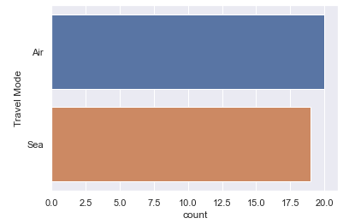
Accomplishments & Challenges
2023
2024
2025
Most used Travel Method
Expenditure trend predictions (Euro Million)
1848.11
1937.79
2027.46
Challenges:
Some of the popular routes are not covered by our Hiring Company
The routes that are actually covered are not advertised to the public (limited to no budget invested on marketing)
Lack of online self - services platform

Slide 6
Conclusions
15%
15%
15%
15%
15%
Spain
UK
€20,000,000
France
QUARTERLY BUDGET
Portugal
Italy

Slide 7
KEY ACTION TERMS
Agree with finance team on investment budget for route expansion, based on surveys
Q2
Agree with finance team on investment budget for expansion Which routes based on surveys
Social Media brand strategy (storytelling, community and engagement)
Creation of information and assistance points with distribution of printed material on events and exhibitions (flyers, leaflets,...)
Q3
Press Tours
Creation of the Business Press Agency and selection for the Marketing staff
Distribution of printed material on busy and in target places (stations, shopping centres,...)
Q4
Articles in selected tourism and nature magazines.
Promotion on catalogs

Slide 8
Engagement Survey Results
Come on board with us and
let’s have a look at the results!

Slide 9
Questions?

Slide 10

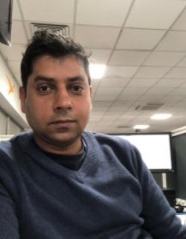

OUR TEAM
Rosgar Montanez
Ram Shah
Anna Floridia
Project Manager and
Business Analyst
sbs22094@student.cct.ie
Researcher
sbs22068@student.cct.ie
Communications Manager
sbs22087@student.cct.ie

Slide 11
THANKS!
Paola: sbs22094@student.cct.ie
Anna: sbs22087@student.cct.ie
Ram: sbs22068@student.cct.ie

Slide 12
Data Dictionary
Datauno
Column | Name of Variable | Definition of Variable | Source | Type Of Variable
0 | Year | Self explanatory | Dataset | Numerical
1 | Region Visited | Countries visited by travellers in population analysed | Dataset | Categorical
2 | total trips | Trips completed by all forms of travel to the countries in population | Dataset | Numerical
Datados
0 | Year | Self explanatory | Dataset | Numerical
1 | Travel mode | Air or Sea used method | Dataset | Categorical
2 | Total Passengers | Self explanatory | Dataset | Numerical
Datacuatro
0 | Year | Self explanatory | Dataset | Numerical
1 | Fair Expenditure | Total amount spent by passengers per year in fare | Dataset | Numerical

Slide 13
REFERENCES
Technology used : Python powered by Jupyter notebook on Anaconda
Code solutions and functions utilised from Stackoverflow and Github
Largest maritime passenger transport fact link

